Slide 1
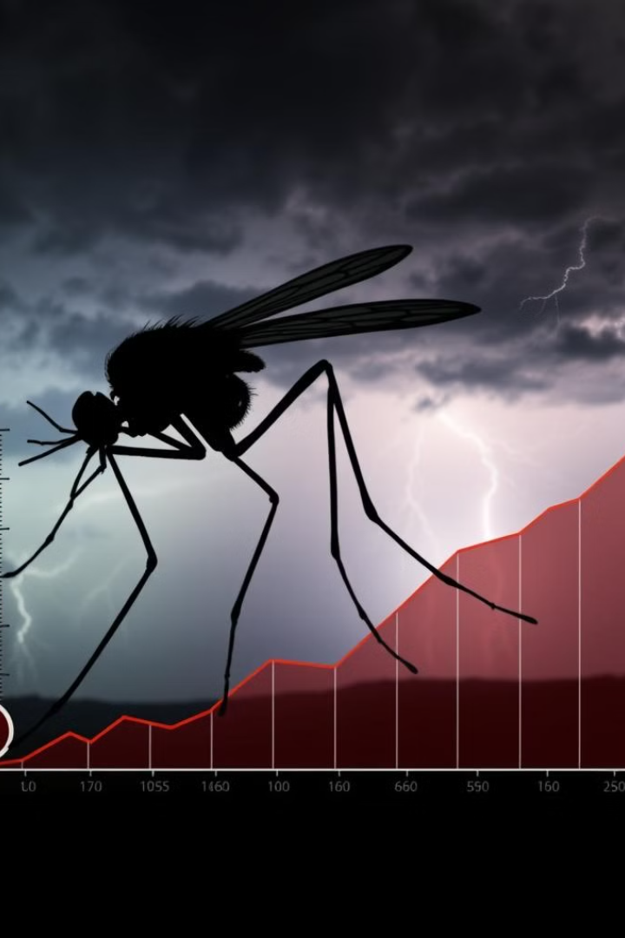
Impact of Climate Change on Vector-Borne Diseases
Ksshitij V Singare RA2211003011509
Vihaan Gautam RA2211028010141
Lalit Satvik Surisetty RA2211003011896
Akshat Sharma RA 2211027010121
Hardik Agrawal RA2211027010007

Slide 2
Table of contents
Introduction Exploring the Impact of Climate Change on Vector-Borne Diseases
Problem Statement The Public Health Challenge of Climate Change
Overview Scope and Analytical Approach
Dashboard Features Key Insights from Power BI Dashboards
Methodology Data Collection and Statistical Analysis
Practical Applications Real-World Impact and Use Cases
Conclusion Summary of Findings and Recommendations

Slide 3
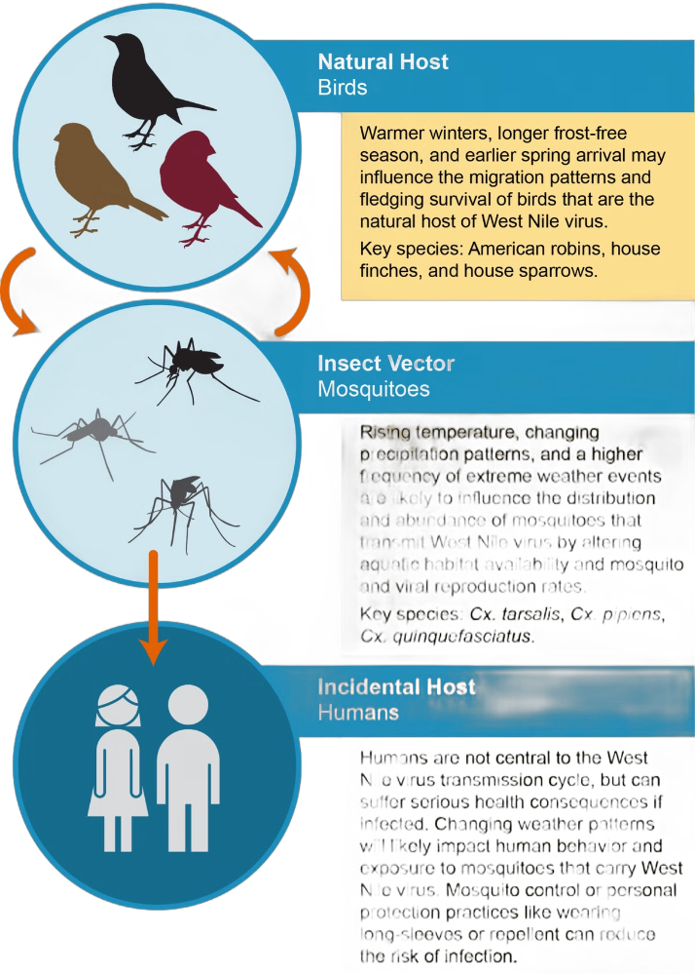
Introduction
Today, we're exploring the profound impacts of climate change on the spread of vector-borne diseases. This analysis focuses on how environmental changes, particularly in climate patterns like rainfall and temperature, influence the behavior and distribution of disease vectors such as mosquitoes and ticks. Understanding these dynamics is crucial for predicting disease outbreaks and preparing effective public health responses.

Slide 4
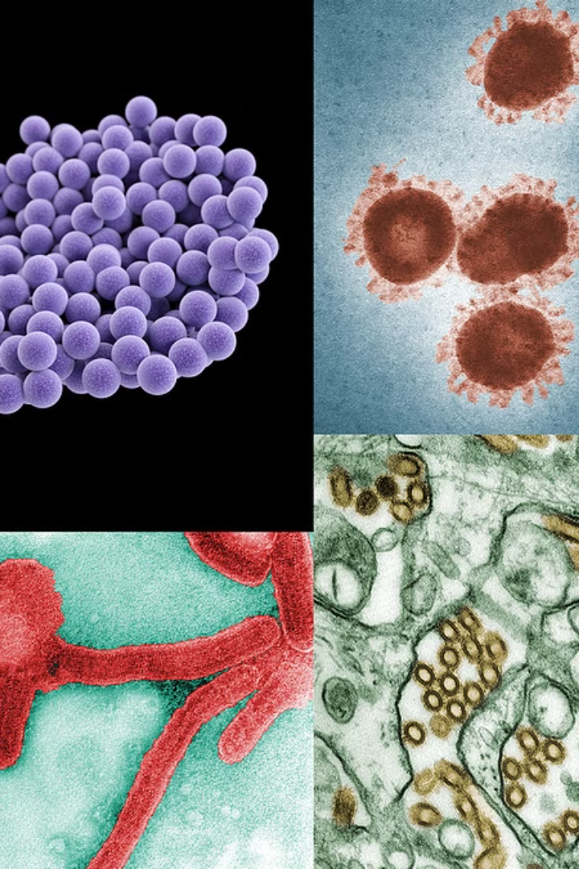
Problem Statement
Climate change is not just a global environmental issue; it also presents significant public health challenges. Changes in temperature, humidity, and precipitation are altering the natural habitats of many vectors, leading to shifts in their geographic distribution and an increase in the rates of diseases they spread.
These changes complicate existing efforts to control and prevent diseases like malaria, dengue, and Zika, particularly in regions where health systems are already under strain.

Slide 5
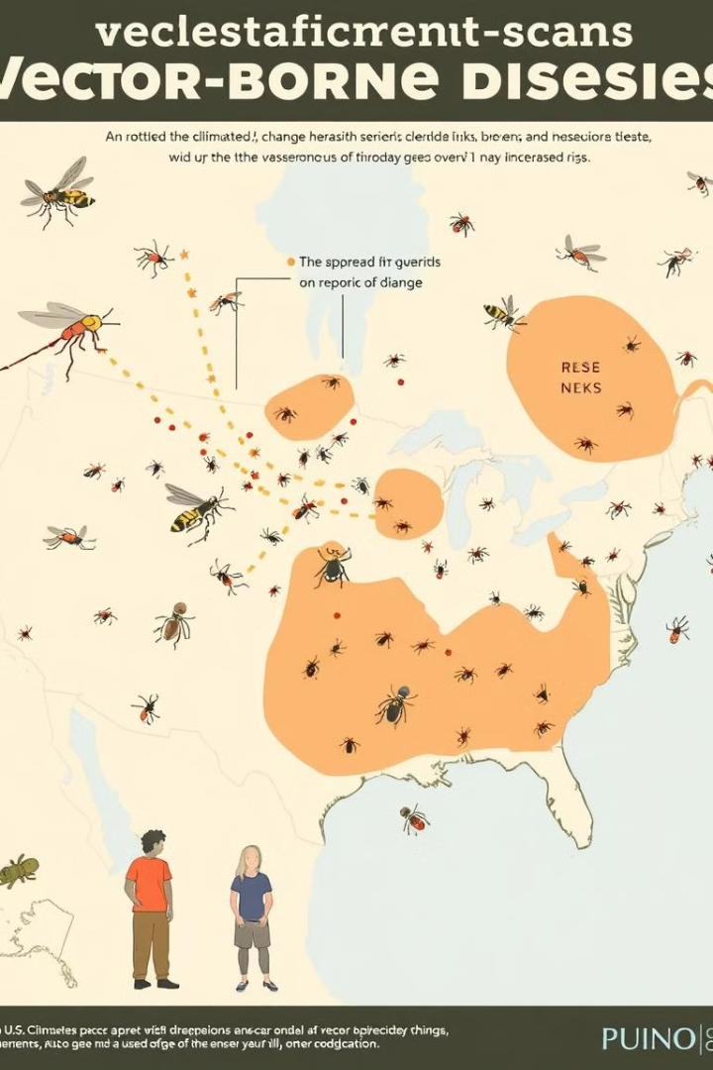
Overview
This presentation details our analytical approach to correlating environmental data with the prevalence of vector-borne diseases across various regions of India. By examining rainfall patterns, water stagnation data, and the occurrence of diseases over several years, we aim to illustrate the direct and indirect effects of climate variables on public health.

Slide 6
Dashboard Features (Power BI)
Explore the powerful visualization and analysis capabilities of Power BI dashboards, designed to unlock insights and drive informed decision-making.
Our Power BI dashboards offer a comprehensive view of the situation:
Region-wise Rainfall Breakdown: Highlights variations across different parts of India.
Range of Rainfall by Value & Average Rainfall Charts: Provide insights into moisture levels that influence vector breeding sites.
Water Stagnation and Fecal Coliform Indicators: Correlates environmental risk factors with potential disease outbreaks.

Slide 7
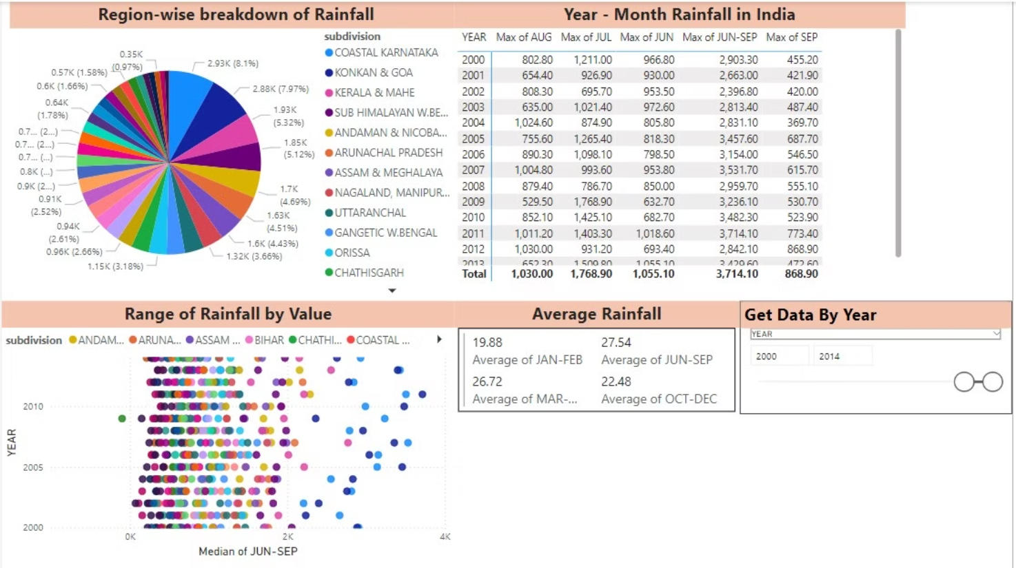

Slide 8
Methodology
Data Collection: Comprehensive gathering of climate data, vector population data, and disease incidence records from various reliable sources.
Spatial Analysis: Utilize GIS mapping and spatial modeling to identify hotspots and patterns of vector-borne disease transmission.
Statistical Modeling: Apply advanced statistical techniques to analyze the complex relationships between climate variables and disease dynamics.
Experimental Studies: Conduct field and laboratory experiments to validate hypotheses and enhance understanding of causal mechanisms.
Iterative Refinement: Regularly review and update the methodology to incorporate new data, emerging research, and changing environmental conditions.

Slide 9
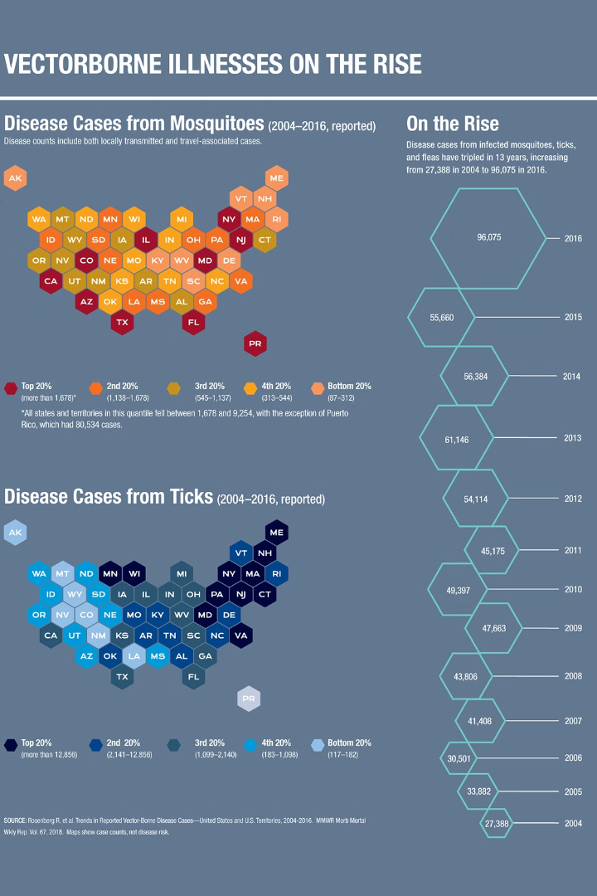
Practical Applications
The insights from our analysis have significant practical applications:
Public health officials can use the data to inform more targeted disease surveillance and control strategies.
Policymakers can allocate resources more effectively to prevent outbreaks.
Community awareness programs based on our findings can educate people in high-risk areas about preventive measures and symptoms.

Slide 10

Final Dashboard

Slide 11
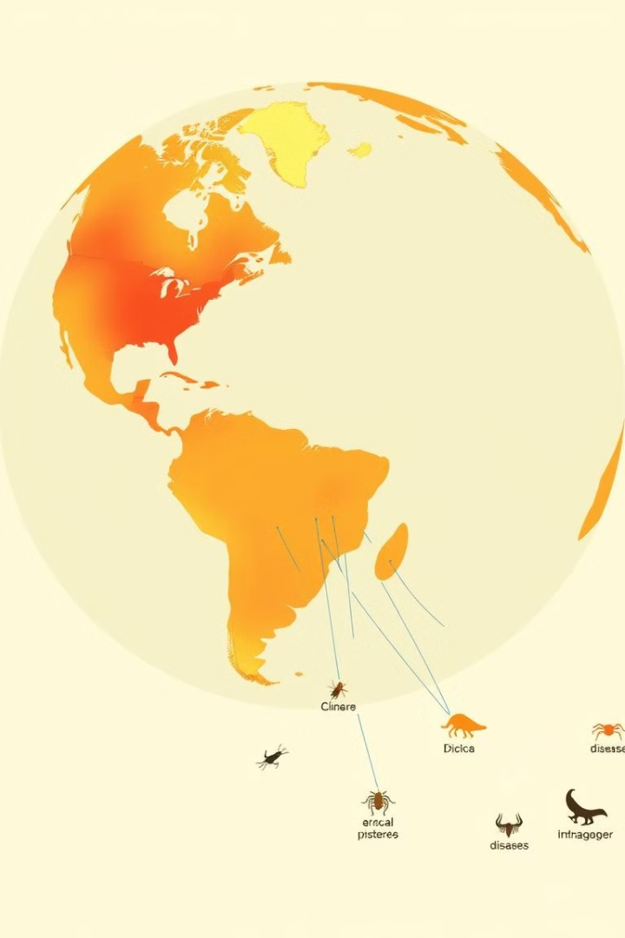
Conclusion
In conclusion, our analysis confirms a notable correlation between climate change and the incidence of vector-borne diseases. The data underscore the need for ongoing monitoring of environmental and health data to dynamically adjust public health responses. We recommend continued investment in research and technology to combat the evolving threat of these diseases.

